Slide 1

Digital Marketing
Marketing Strategy Session

Slide 2
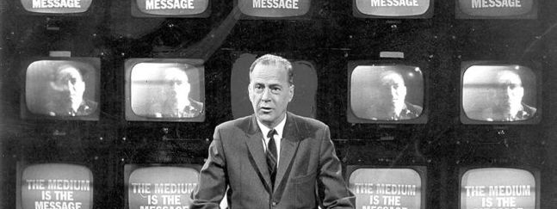
Medium is the message
Marshall McLuhan

Slide 3
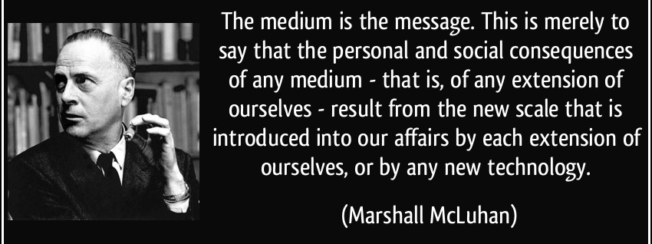
Digital marketing is not technology alone
It is about your message
and overall strategy

Slide 4

Traditional v/s digital marketing
Traditional marketing is pushing the message out
Digital marketing is using message to pull people in
The marketing 4 Ps still exist
Product
Price
Promotion
Place

Slide 5

7 C’s of Digital marketing
Content
Conversation
Convenience
Customization
Collaboration
Context
Convergence

Slide 6

Brand identification and consistency
Need a compelling customer centric story
Need a consistent brand identity design

Slide 7

Brand identity
Branding speaks largely to your company’s visual identity including factors such as your logo, color scheme, fonts, and layout.
However, brand identity should also include all media messaging and may include a tagline, headline and key value propositions
Together, the key graphic and verbal elements define your company personality

Slide 8

Digital Marketing and Customer experience design
Persona
Task Models
Journey Mapping
Content Requirements
Information Architecture
Wireframes / Prototyping
Usability Testing

Slide 9

Growth hacking
Growth hacking is a marketing technique developed by technology startups which uses creativity, analytical thinking and social metrics to sell products and gain exposure
Traffic acquisition
User activation
User retention
Revenue generation

Slide 10

Website
Your website is the hub of your digital marketing activities
Each page should have a purpose and practical buyer paths that compel visitors to take action must be put in place to support your conversion goals
The most effective website are not only carefully planned and executed, but are perpetually refined to continuously improve results

Slide 11
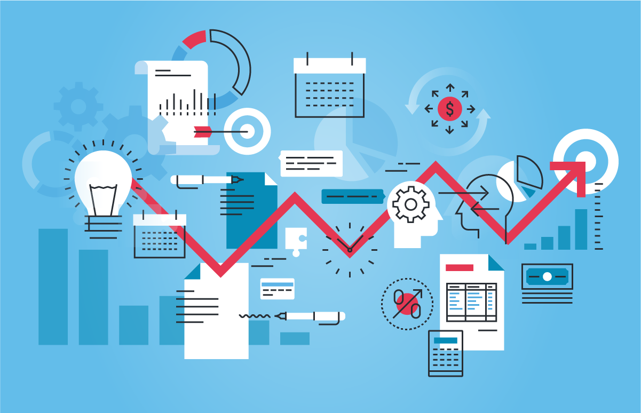
Pay per click advertising
If you need to produce website traffic fast, PPC and programs offered by Google, the other search engines and social media channels, create instant visibility to generate traffic leads and sales

Slide 12
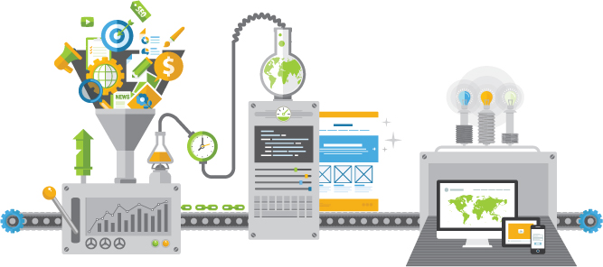
Content planning
Nearly every digital marketer in the world realizes content marketing is the fabric of their search and social programs and can play a critical role in every phase of the buying cycle

Slide 13

Business blogging
The blog is the center piece of the most companies content marketing efforts
Effective planning for your business blog includes targeting and editorial planning
It is important to have an interesting mix of ideas, an uncompromising commitment to quality writing, and clean presentation

Slide 14
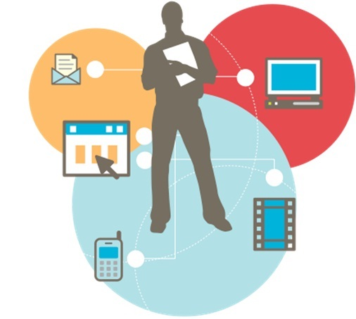
Guest blogging
Contributing blog posts to authoritative websites in your industry is one of the best ways to increase your reach, expand your audience, build your credibility and drive traffic to your website.

Slide 15
Curation
Curation is presenting the works and ideas of others
But it is not cutting and pasting stories from around the web merely to add pages to your website and blog
Done well, curated content expresses a point of view and heightens your authority

Slide 16

Content promotion
In this age of content overload, you need to take advantage of the combination of owned, earned, and paid media channels to amplify the reach of the content you work so hard to produce.

Slide 17

Visual marketing
Online visual marketing includes images for web pages and social media including photos, illustrations, diagrams, infographics, presentations, webinars, eBook design and many more.

Slide 18

Presentations
Slideshows and other types of digital presentations can become a powerful part of your media mix
LinkedIn SlideShare gets millions of views each day making it a great channel to reach a larger audience
SlideShare presentations are not only shared, but often embedded in blogs

Slide 19

Video
Video can help you boost your success in social media and search, generate leads and increase conversion
It is no longer a medium reserved for big budgets
A smart phone or computer is all you need to capture ideas and share them

Slide 20
Podcasting
Podcasting is another great medium you can jump into with minimal equipment and begin making a personal connecting with your audience
Appearing on, hosting interview program, also presents tremendous opportunities to expand your network

Slide 21
Webinars
Marketers consistently rate webinars as one of the most effective tactics
They can deliver wide reach cost effectively and remain and asset afterwards
A webinar that is well researched, planned and designed can generate leads, convert leads to paying customers, improve customer retention and grow revenues from existing customers

Slide 22

Search marketing : Interesting numbers
Around 89% of the consumers use a search engine to find information on products or services before buying
70% of the purchase decisions begin with a search

Slide 23
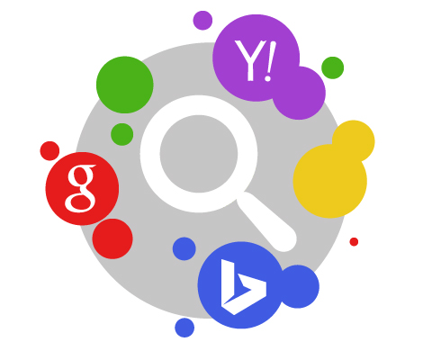
Search Marketing fundamentals
Search Engine Marketing is known as the low hanging fruit of paid digital marketing

Slide 24
Content marketing mission statement
Our company is where
[ Audience X ] finds [ Content Y ] for [ Benefit Z ]

Slide 25
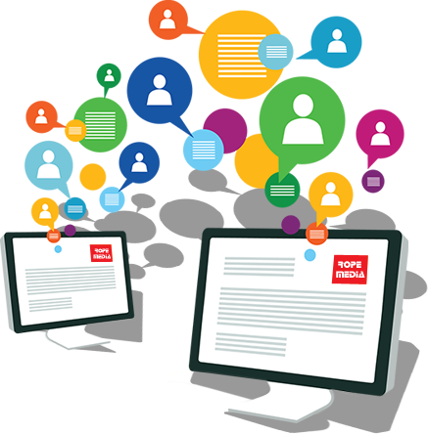
Content optimization
Known as the Digital Marketing Silver Bullet
If a website does not have valuable, original content, it won’t perform well
Content should be optimized for email contact, different browsers and mobile devices
Search Engines punish websites that doesn’t have frequently updated content
It is a good idea to setup a blog, and reach out to other bloggers and web masters to feature your content in their websites

Slide 26
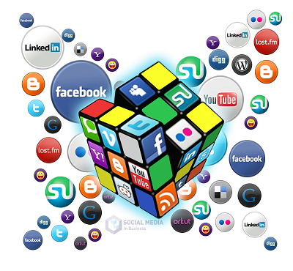
Social media marketing
Social Media helps to create conversations with customers
Social Media can help you to accelerate your email marketing campaigns
It is recommended to select a set of social media channels and concentrate on mastering them
Business based on Brand Identity – Pinterest
Business based on News Feeds – Twitter
Business based on Culture – Instagram
Business based on Rich Media – Youtube
Business based on Location Services – Foursquare
Business based on Thought Leaders - Quora

Slide 27
Lead generation and digital marketing
It takes at least seven separate touches for the customers to respond
One site visit is not going to help you in the long term
Invite new visitors to sign up for your news letter, download a whitepaper or fan you on Facebook

Slide 28
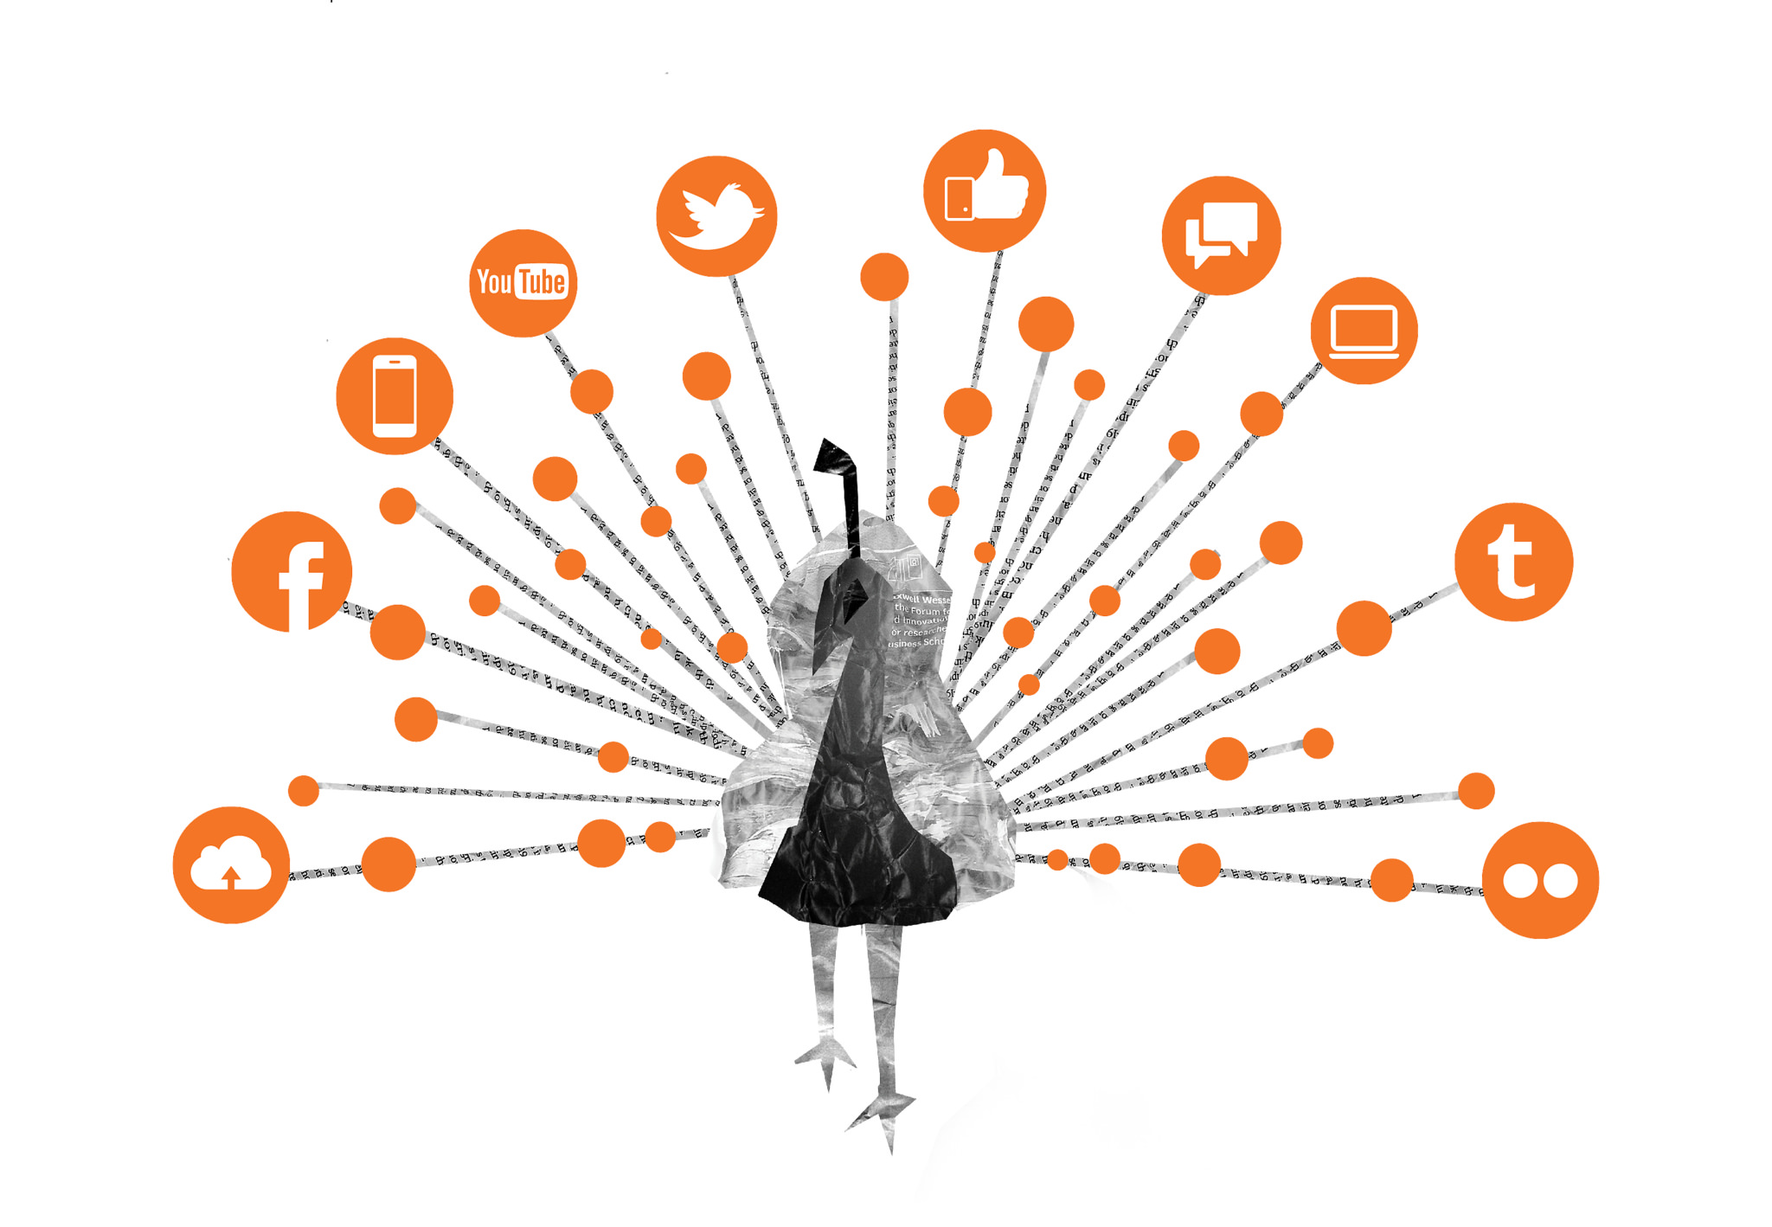
Essentials for digital marketing success !!
A flexible website
Marketing Automation
Regular and Fresh content
Building a steady stream of visitors
Developing a Social Face to the Company
Implementing monitoring and tracking systems
Well optimized conversion process

Slide 29
Content Marketing essential steps
Decide the topics you plan to publish
Key phrases you plan to target in search engines
Influencers you plan to collaborate with
Networks and groups plan to activate within
Publications you would like to write for
Formats you plan to use

Slide 30

Create your blog identity
Wordpress
Blogger
Livejournal

Slide 31
Create your Content
Canva

Slide 32
Create your news feeds
Twiiter

Slide 33
Create your social channels
Facebook
Instagram
Pinterest

Slide 34
Thank you
Infinity Labs
UST Global

